Slide 1

Goal:
3d atlas construction from images of 2d sections
Part 1: Duane Rinehart- Polygon drawing tool for high resolution annotation of brain shapes
Part 2: Yoav Freund- Computational routines for semiautomated alignment of 3D brain data to a common reference space
20 May 2022
Notes:
Overview of Brain Structure Annotation Tools v2

Slide 2
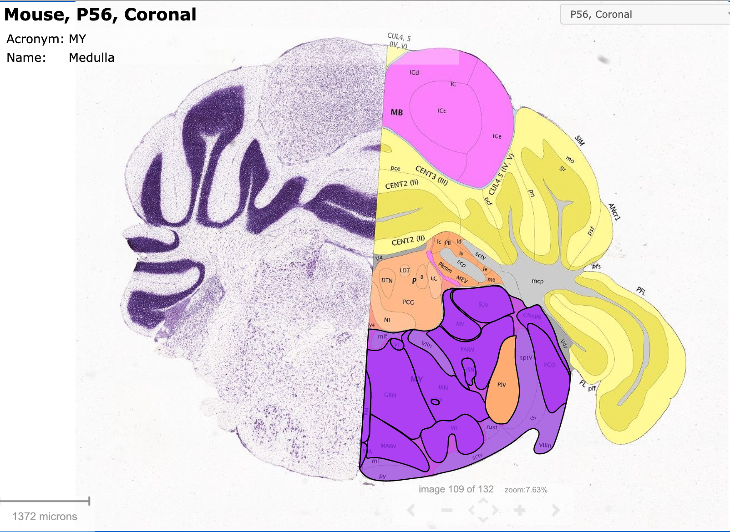
Border annotations utilize LM imaged cytoarchitecture

Slide 3
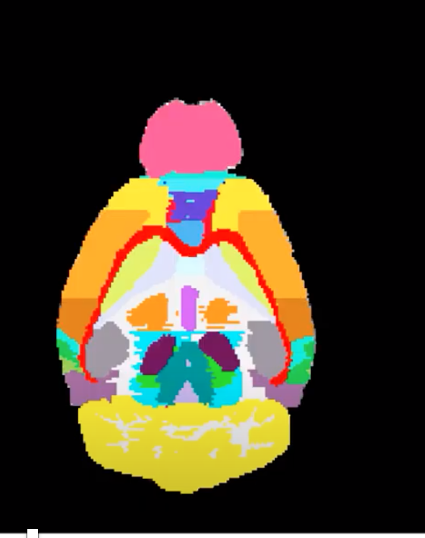

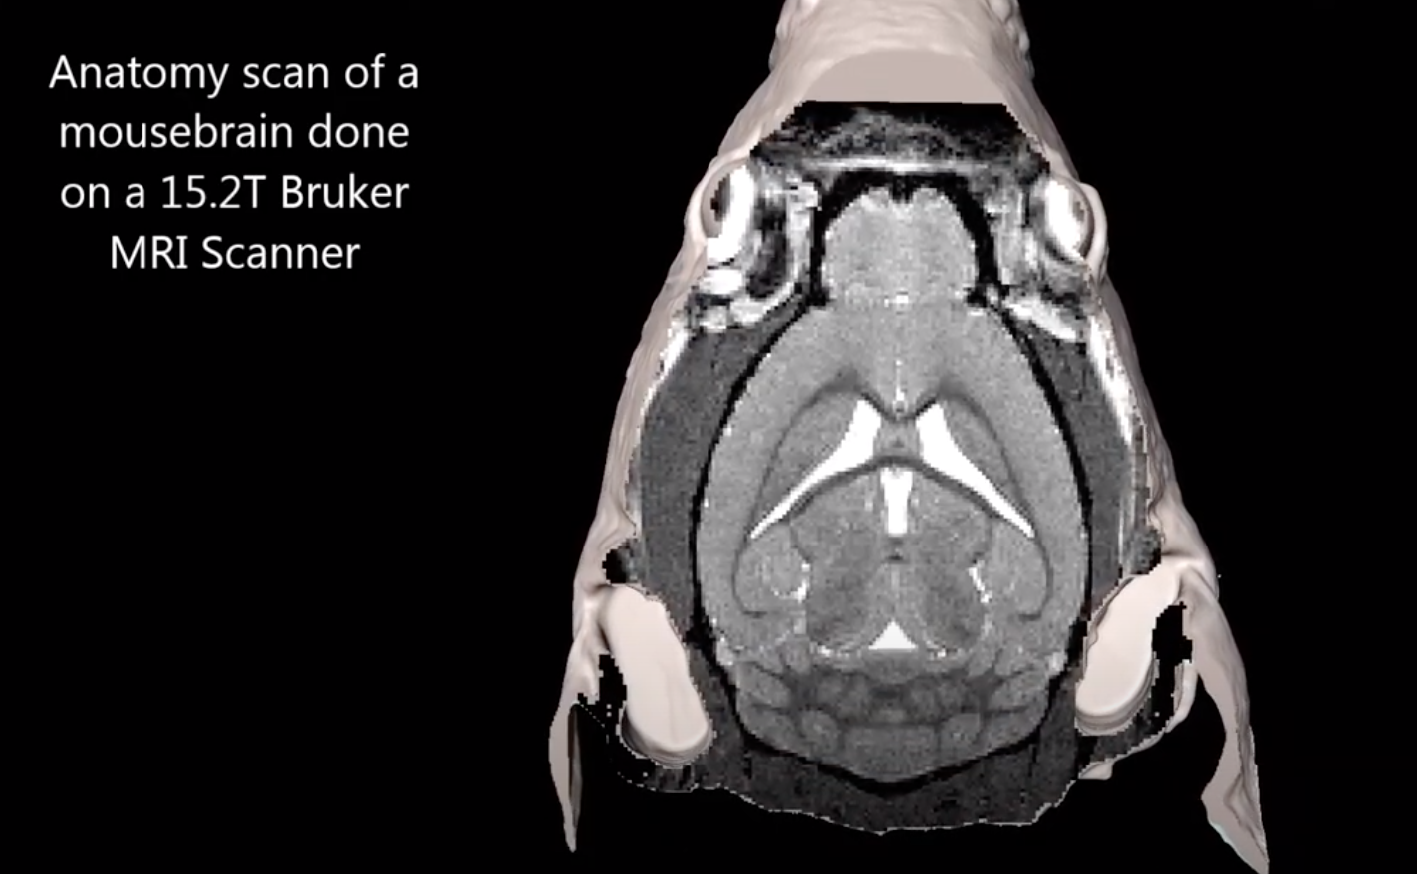
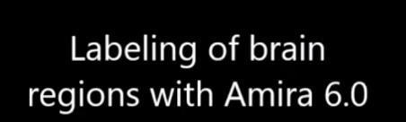
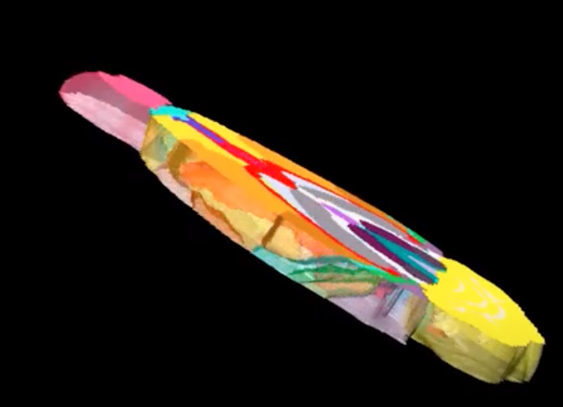
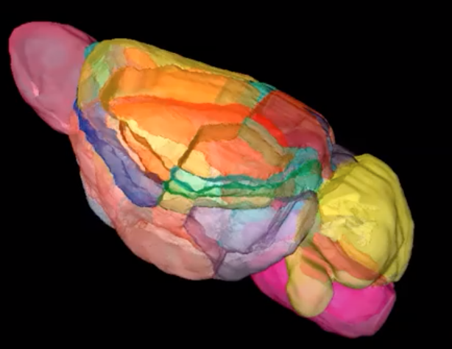

MRI supports 3D imaging via:
1.Image acquisition in 3D so alignment is automatic
2.Borders can be directly annotated across 3D registration of images
1
2
3
4

Slide 4
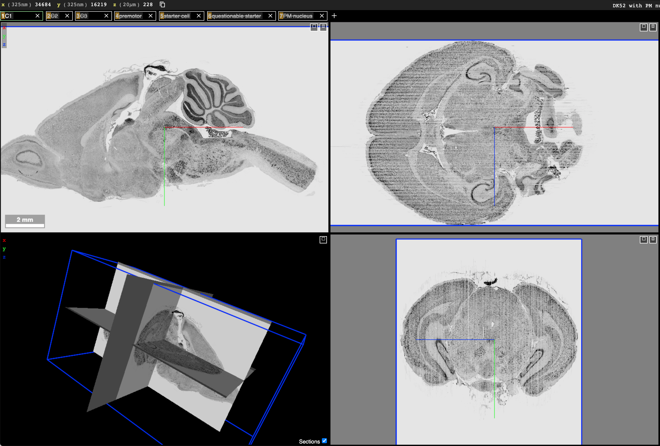
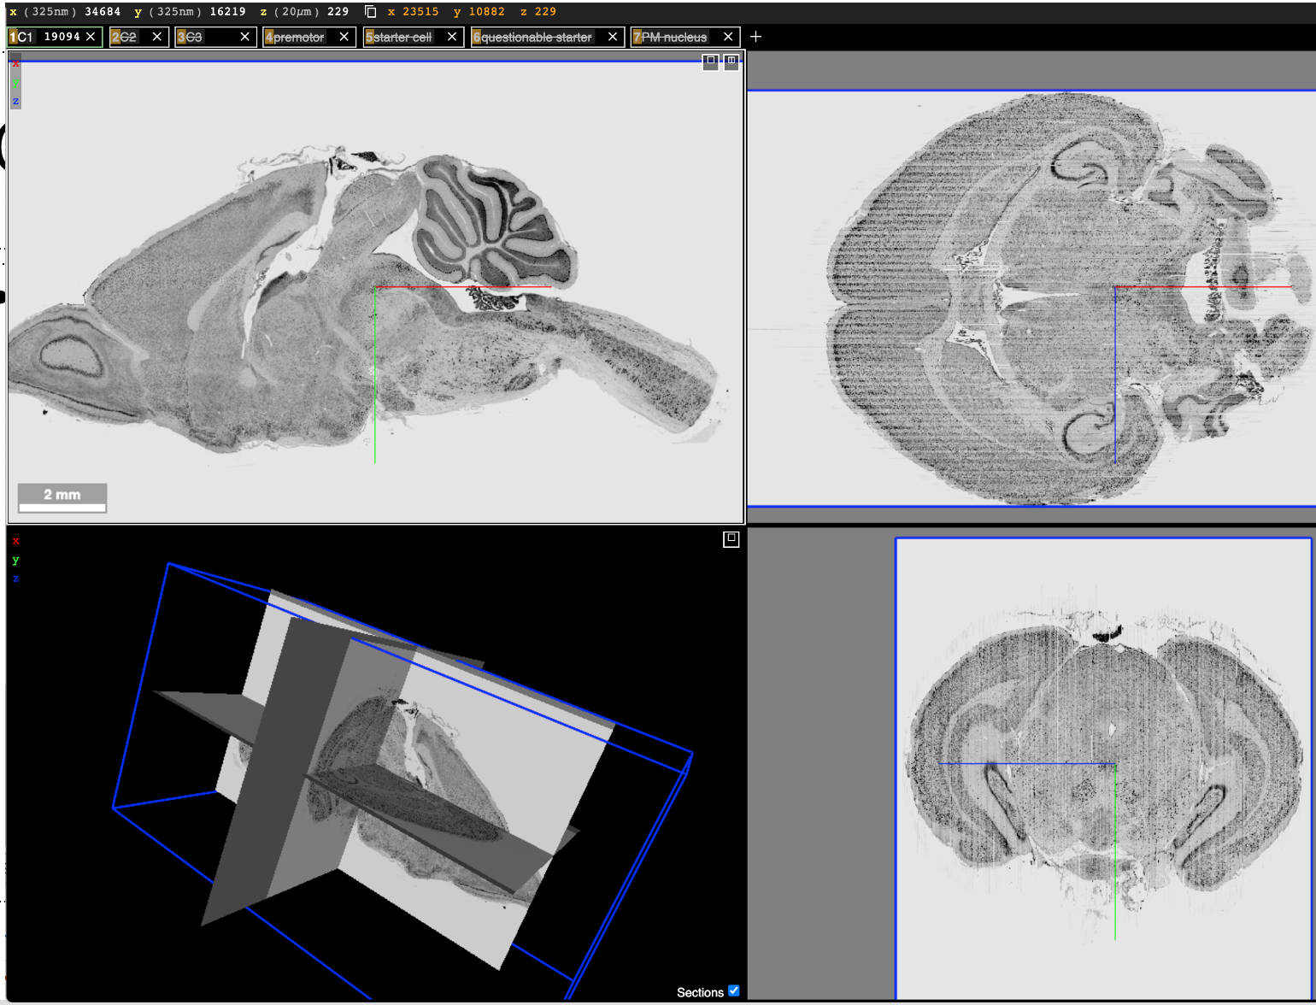
Previous progress: Neuroglancer display of
aligned LM images of serial brain sections
Sagittal-real section plane
Horizontal-virtual re-section
Coronal-virtual re-section

Slide 5
BrainSharer - Based Full-Resolution Contouring Tool
Collaboration Team:
Ed O’Donnell, Beth Friedman, Yoav Freund, David Kleinfeld, Marissa Moreno, Subramanyam “Naga” Makam, Kui Qian, Duane Rinehart, Samuel Wang (Princeton), Zhongkai Wu
10 May 2022
Notes:
Overview of Brain Structure Annotation Tools v2

Slide 6
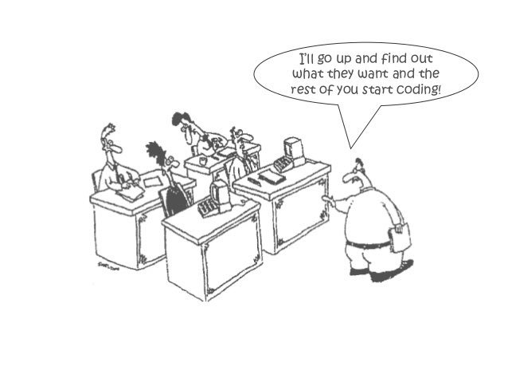
Background
Add scanned images to a database, add good 3-D tools and web availability so anatomists can interact across sites.
Supports development of an “active” brain atlas
What could go wrong?

Slide 7
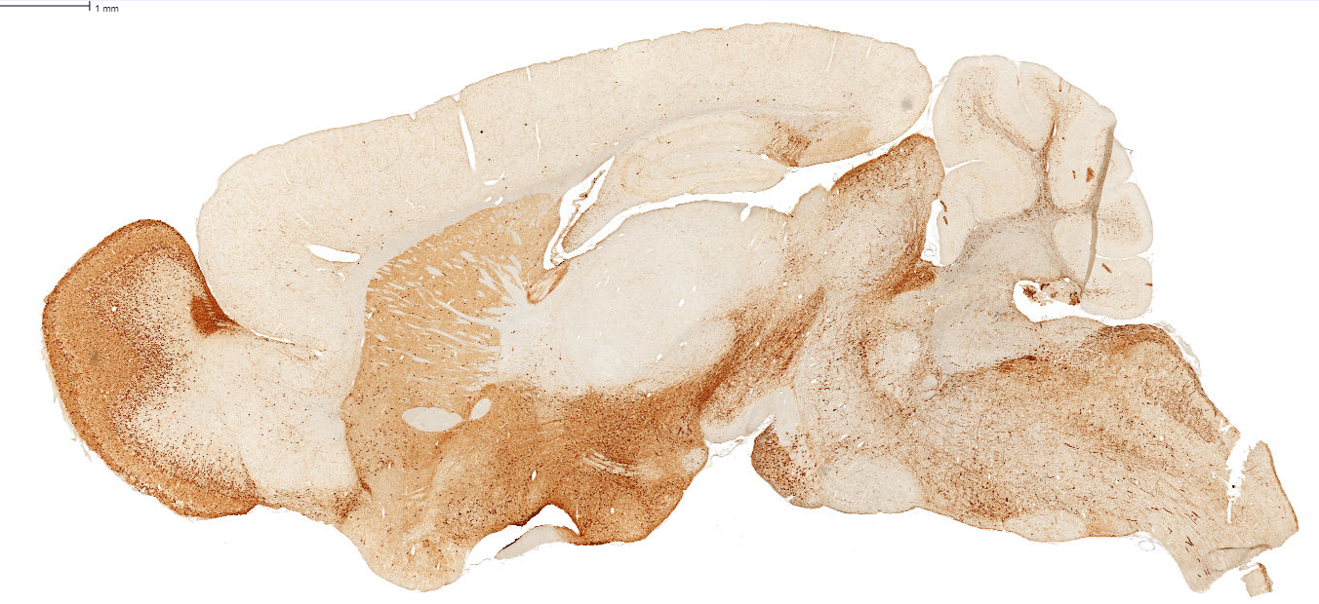

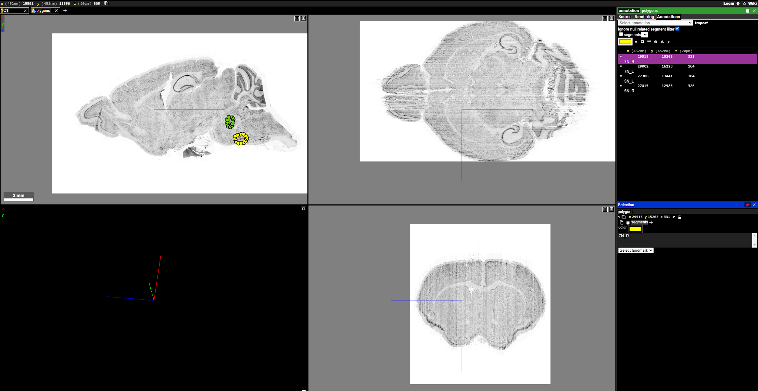
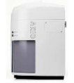
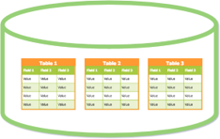
BrainSharer Platform
Scanning the brain
Data Storage (Files & Database)
NeuroGlancer
Web server
Relational database
Notes:
A holistic view of the workflow is diagrammed starting from the brain image scanning, uploading compressed images and metadata to the database for dissemination to a wide audience of anatomists who will directly access the Brainsharer platform.
This diagram describes the back-end systems used to get the data into Neuroglancer, including the image processing and preparation into a web server. In addition metadata is stored in a relational database for advanced filtering and annotation storage.

